Slide 1
Regression Biology 683 Lecture 6 Heath Blackmon

Slide 2
Last week
Midterm
P-values
Bayes Theorem
Reproducibility Crisis

Slide 3
Today
Simple Linear Regression
General Linear Models

Slide 4
Correlation vs Regression
Both methods are ways to explore contingency between variables.
Regression describes the degree to which we can predict the value of one variable based on the value of another.
Regression calculates a line that describes this relationship between a response and explanatory variable.
Use regression when you believe there is a strong case for causation.

Slide 5
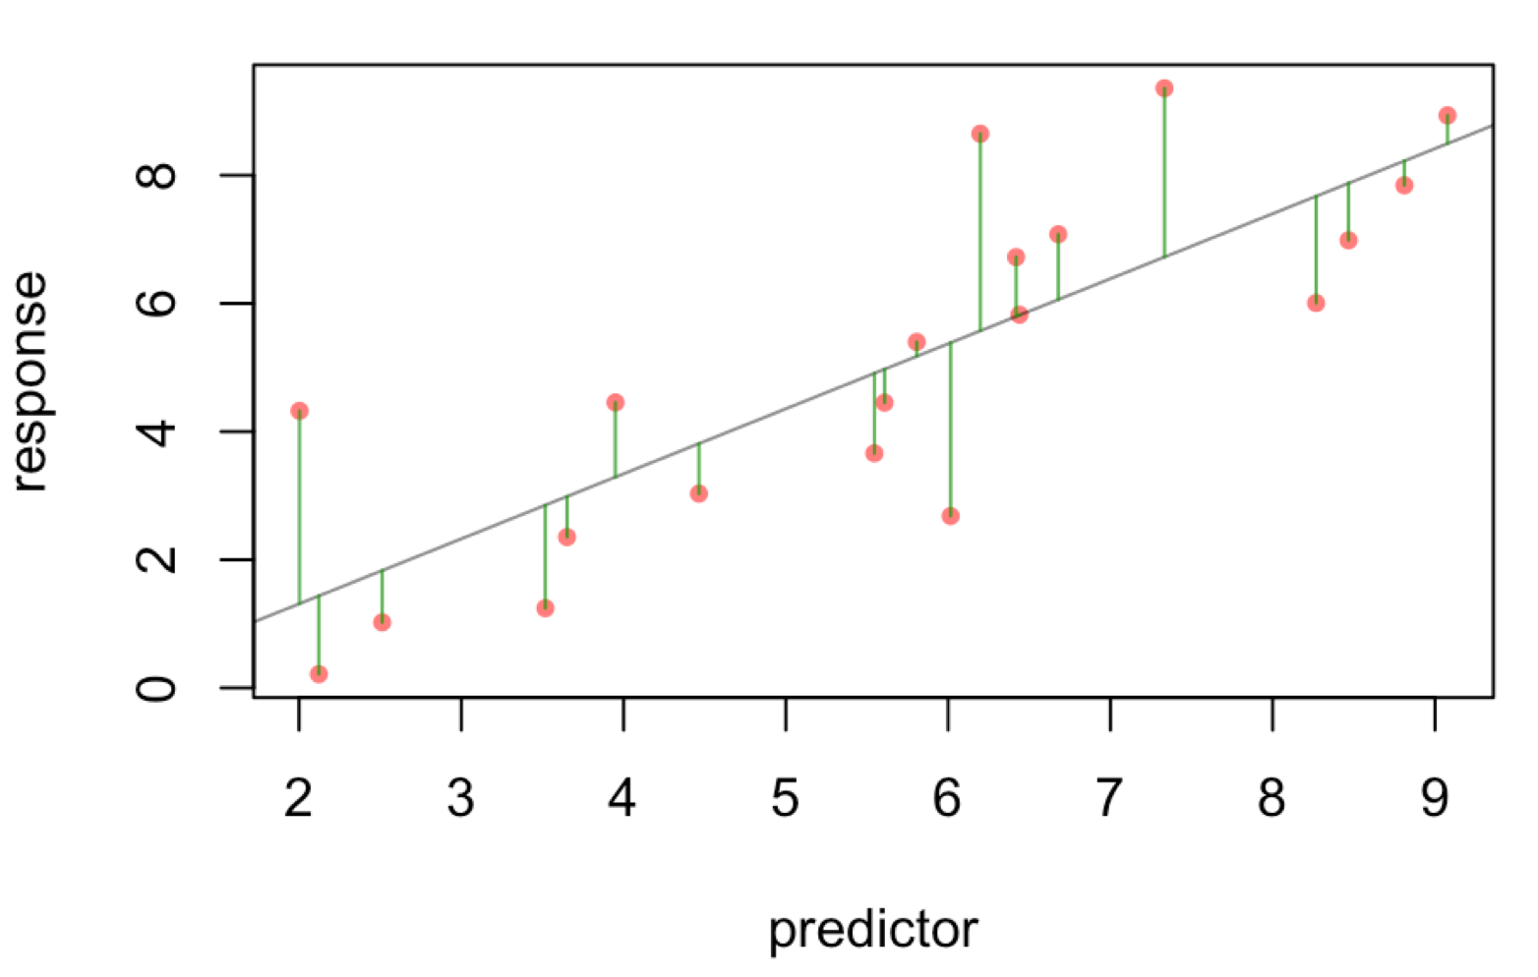
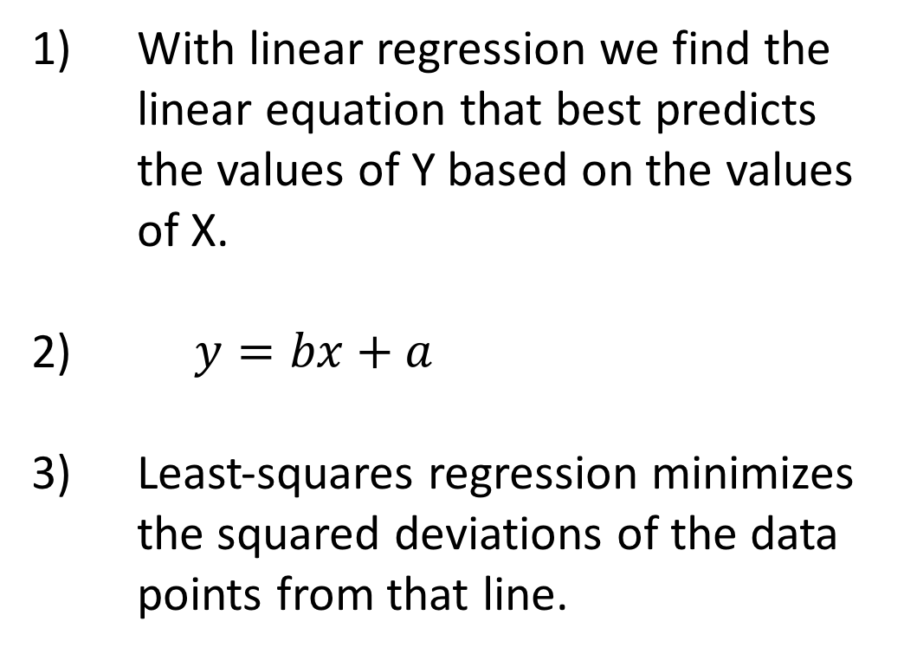
Regression in R
With linear regression we find the linear equation that best predicts the values of Y based on the values of X.
$y=bx+a$
Least-squares regression minimizes the squared deviations of the data points from that line.

Slide 6
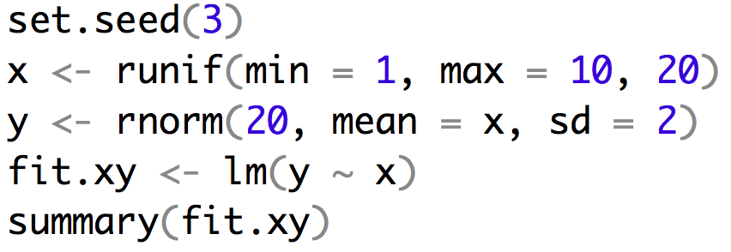
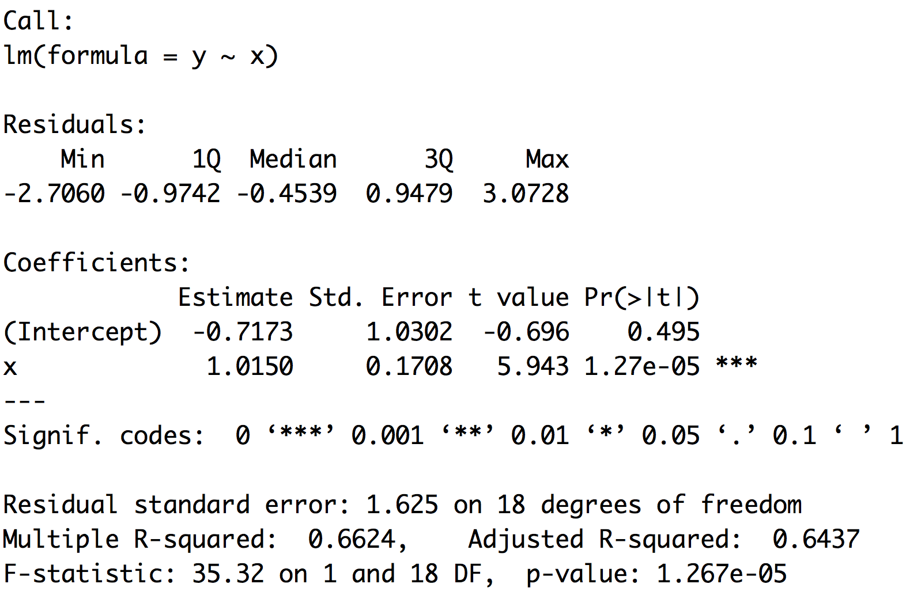
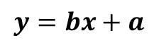
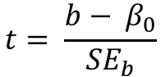
Example of regression
$$y=bx+a$$
$$t= \frac{b− β_{0}}{{SE}_{b}}$$

Slide 7
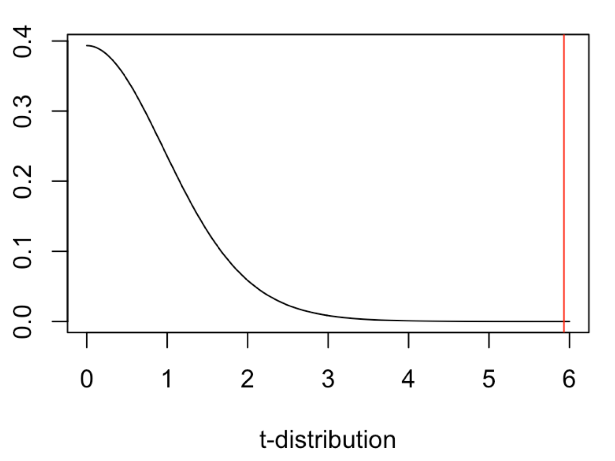
Example of regression
$$y=bx+a$$
$$t= \frac{b− β_{0}}{{SE}_{b}}$$

Slide 8
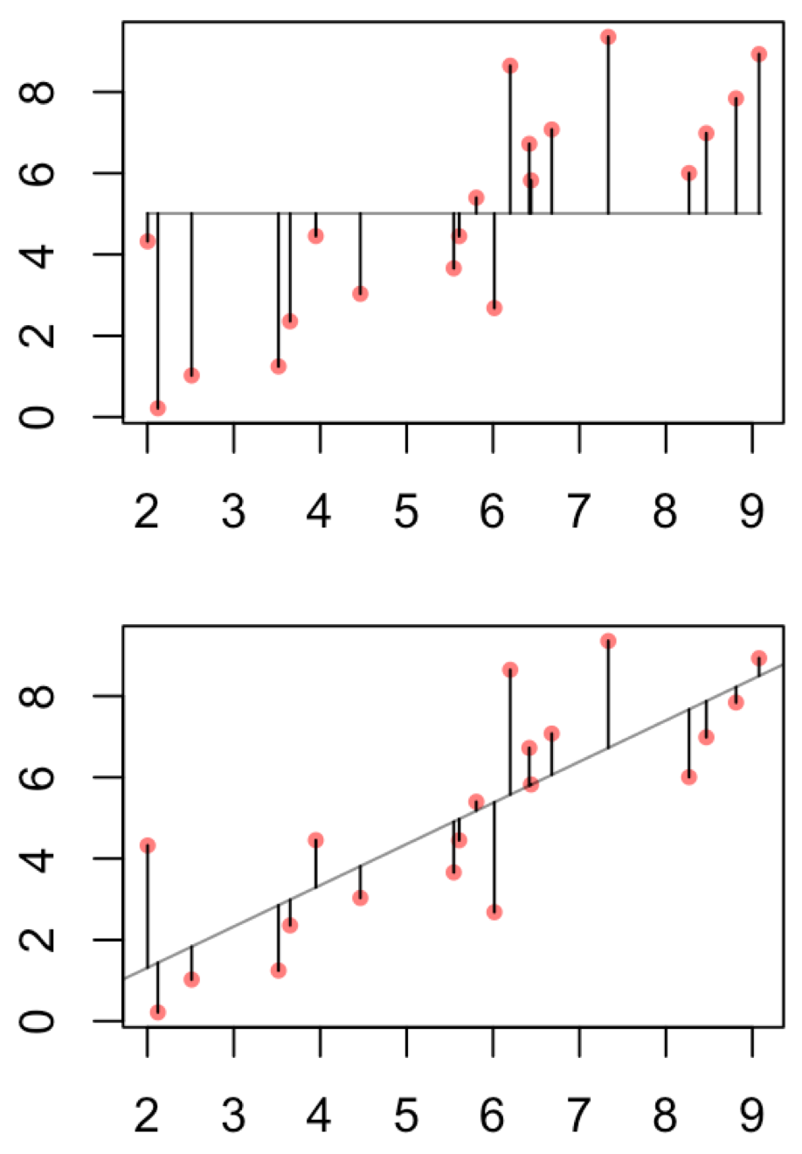
Example of regression
This can help to justify the biological importance
assuming you have a regression that is significant.
It is the proportion of total variance explained by
the regression.

Slide 9
Linear regression uses
Depict the relationship between two variables in an eye-catching fashion
Test the null hypothesis of no association between two variables
The test is whether or not the slope is zero
Predict the average value of variable Y for a group of individuals with a given value of variable X
variation around the line can make it very difficult to predict a value for a given individual with much confidence
Predictions outside of the range of observed data is generally discouraged
Used both for experimental and observational studies

Slide 10
What are Residuals
In general, the residual is the individual’s departure from the value predicted by the model
In this case the model is simple – the linear regression – but residuals also exist for more complex models
For a model that fits better, the residuals will be smaller on average
Residuals can be of interest in their own right, because they represent values that have been corrected for relationships that might be obscuring a pattern.

Slide 11
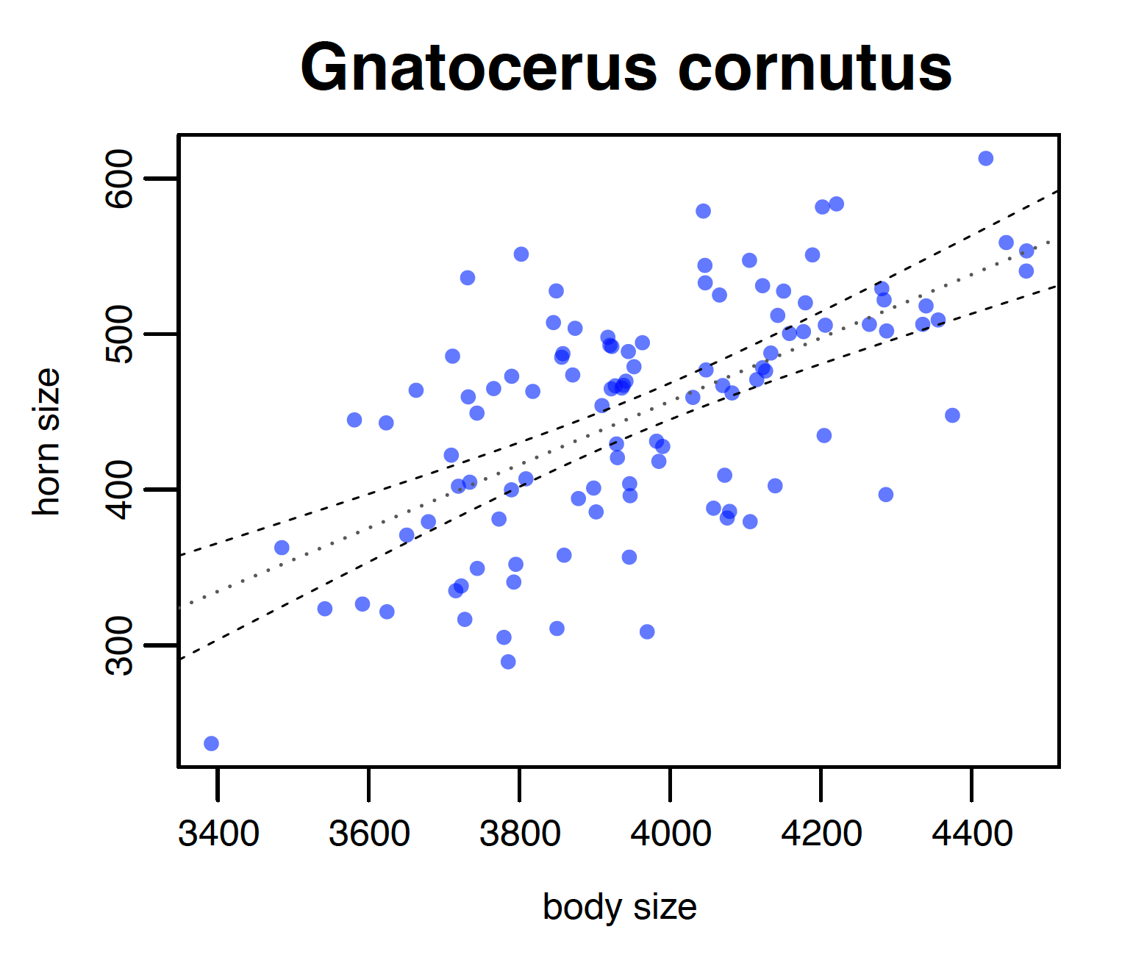
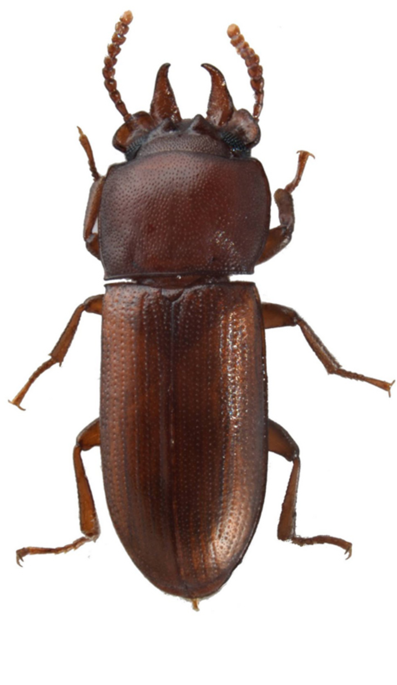
What are Residuals
Horn Size
Body Size

Slide 12
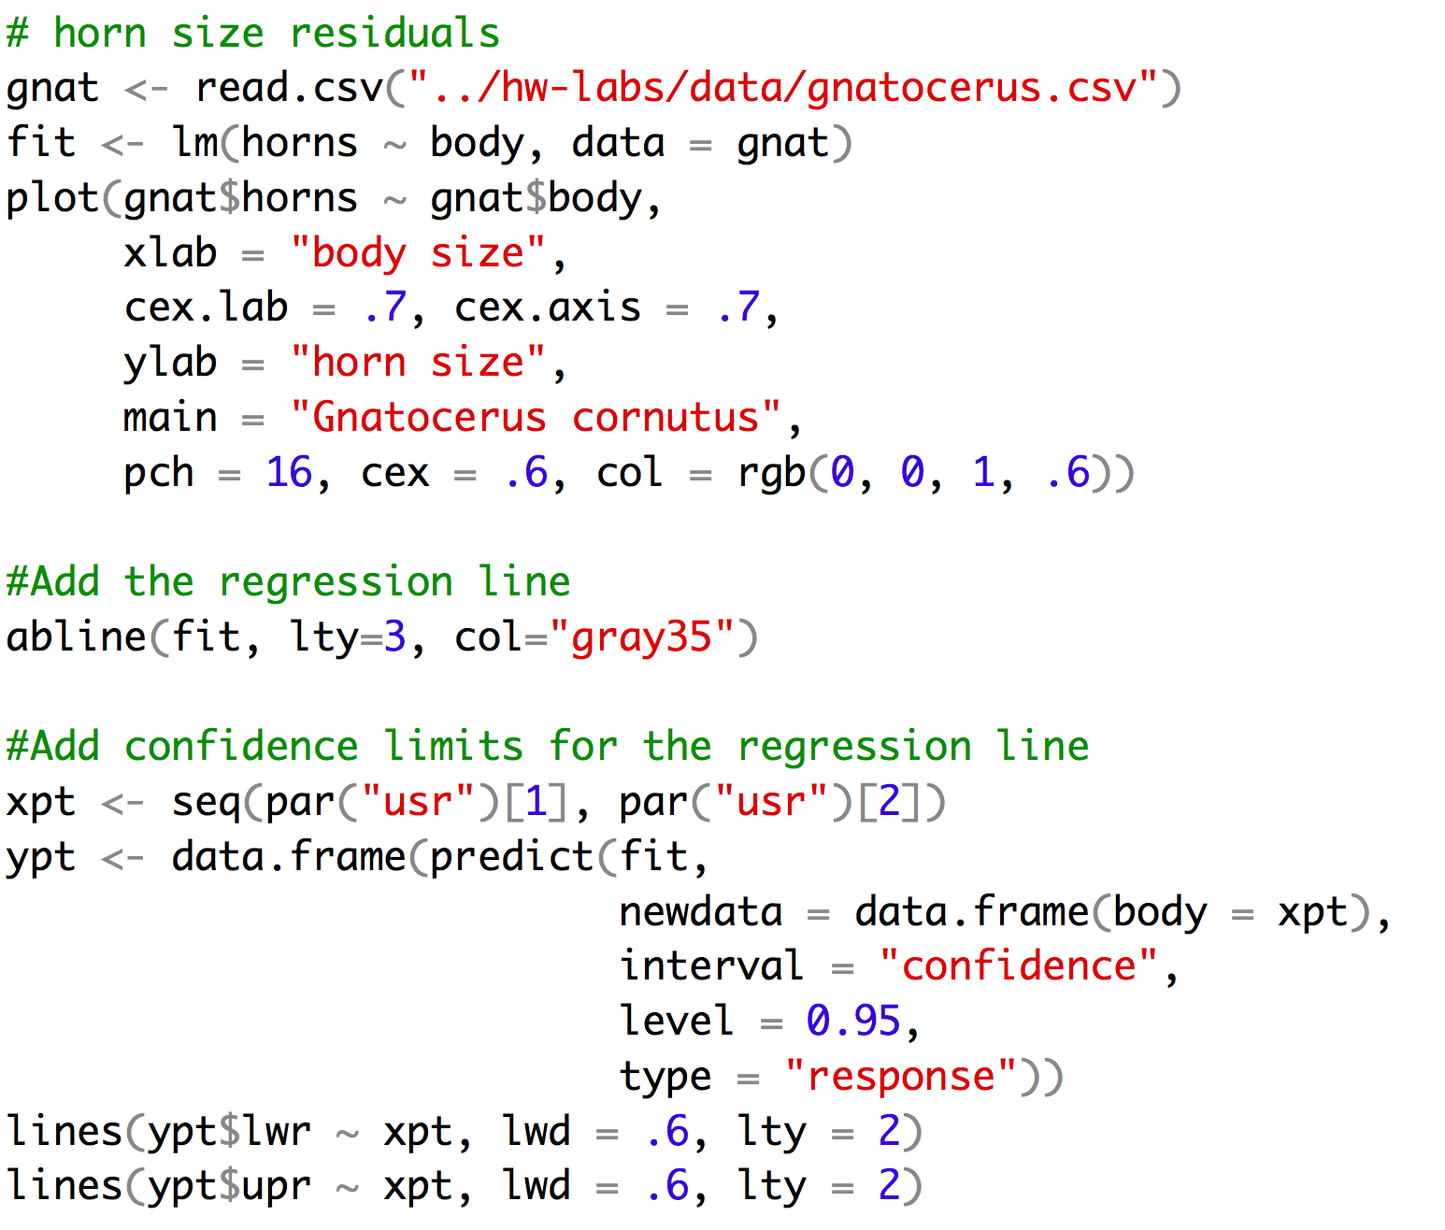
Making that plot

Slide 13
Strong Inference for Observational Studies
Noticing a pattern in the data and reporting it represents a post hoc analysis
This is not hypothesis testing
The results, while potentially important, must be interpreted cautiously
What can be done?
Based on a post-hoc observational study, construct a new hypothesis for a novel group or system that has not yet been studied

Slide 14
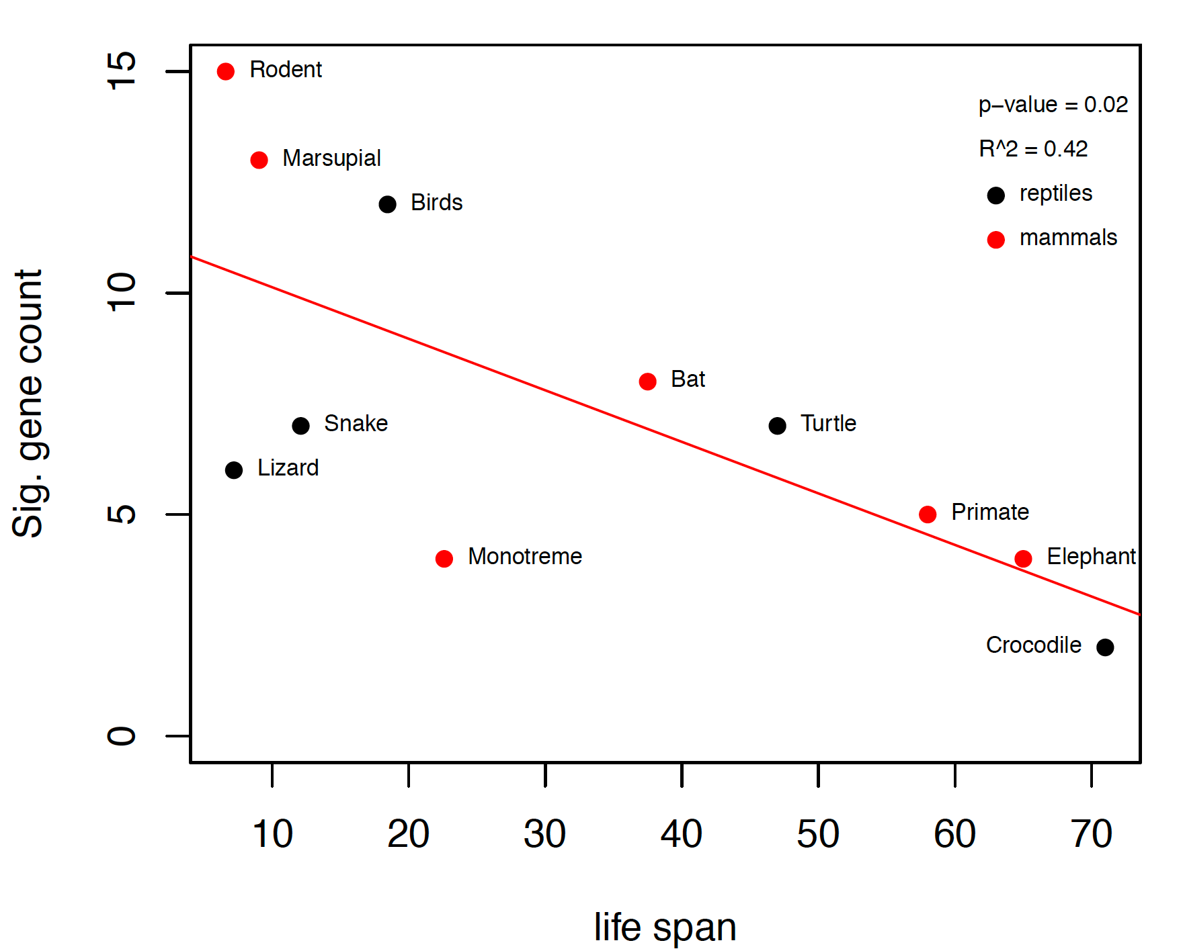
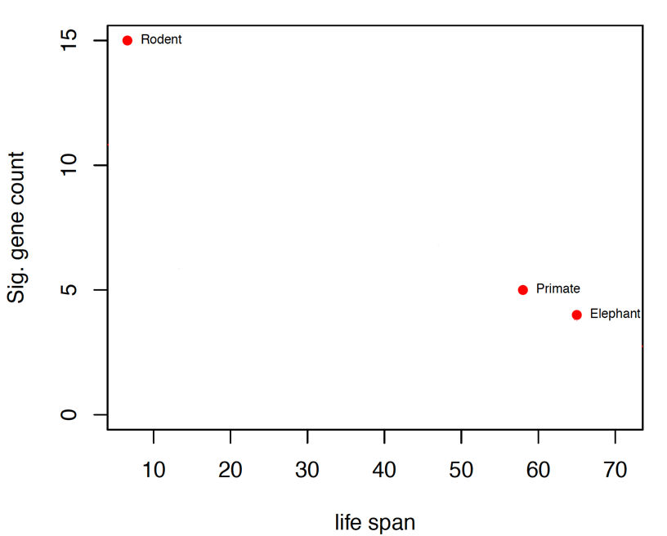
Example
We already knew that the P53 network is important in guarding against cancer in long lived species.
We also knew that primates and elephants show rather little change in this network when compared to rodents.
Collect data on many more species and test apriori hypothesis that there will be a significant and negative regression coefficient.

Slide 15
Assumptions of Linear Regression
The true relationship must be linear
At each value of X, the distribution of Y is normal (i.e., the residuals are normal)
The variance in Y is independent of the value of X
Note that there are no assumptions about the distribution of X

Slide 16
Common Problems
Outliers
Regression is extremely sensitive to outliers
The line will be drawn to outliers, especially along the x-axis
Consider performing the regression with and without outliers
Non-linearity
Best way to notice is by visually inspecting the plot and the line fit
Try a transformation to get linearity [often a log transformation]
Non-normality of residuals
Can be detected from a residual plot
Possibly solved with a transformation
Unequal variance
Usually visible from a scatterplot or from a residual plot

Slide 17
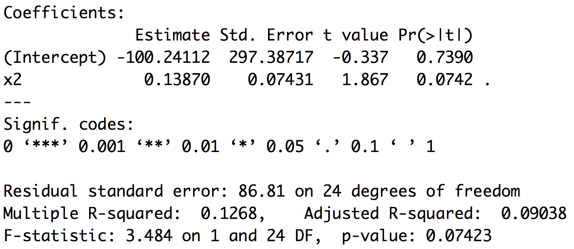
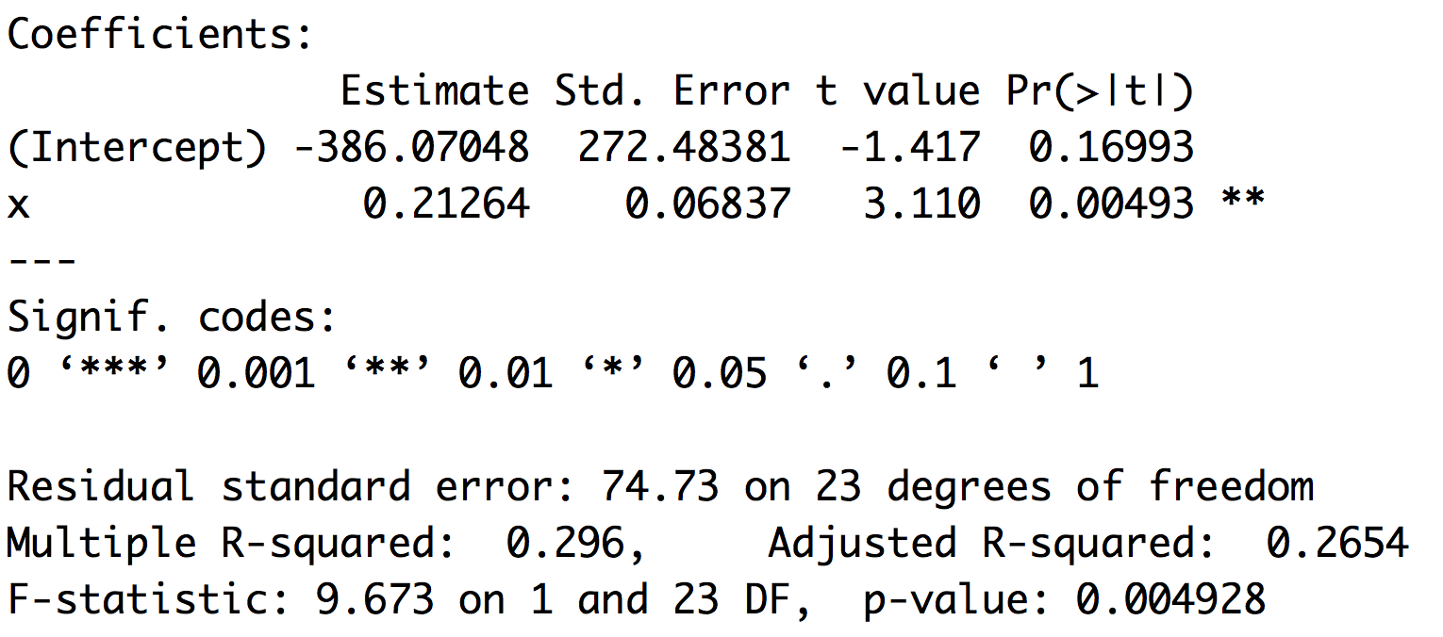
Outliers
Leverage and cooks distance

Slide 18
Moving past simple models
The reason ANOVA is so widely used is that it provides a framework to simultaneously test the effects of multiple factors
ANOVA also makes it possible to detect interactions among the factors
ANOVA is a special case of a general linear model
Linear regression is a special case of a general linear model

Slide 19
GLM and LM function in R
The GLM and LM function in R takes equations that can be described with the following operators
+ +X include this variable
: X:Z include the interaction between these variables
∗ X∗Y include these variables and the interactions between them
^ (X + Z + W)^3 include these variables and all interactions up to three way

Slide 20
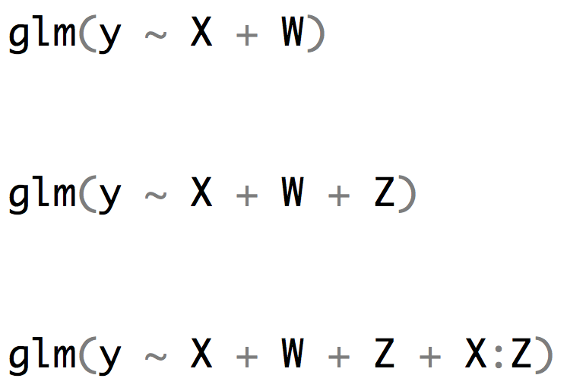
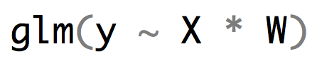
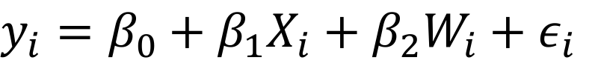
R versus the math implied
$y_{i}=β_{0}+β_{1}X_{i}+β_{2}W_{i}+ε_{i}$
$y_{i}=β_{0}+β_{1}X_{i}+β_{2}W_{i}+β_{3}{X_{i}W}_{i}+ε_{i}$

Slide 21
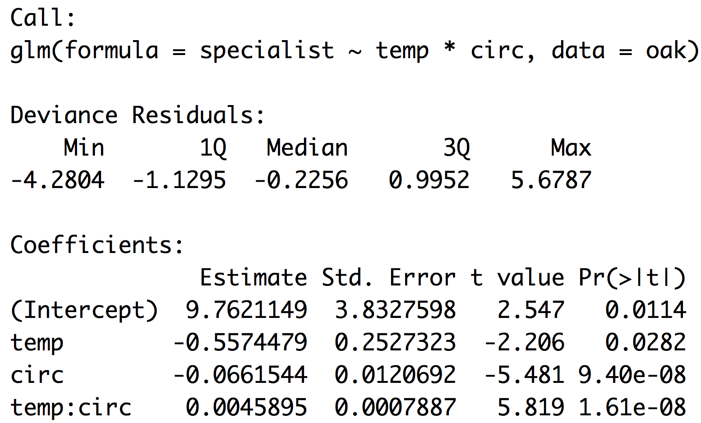
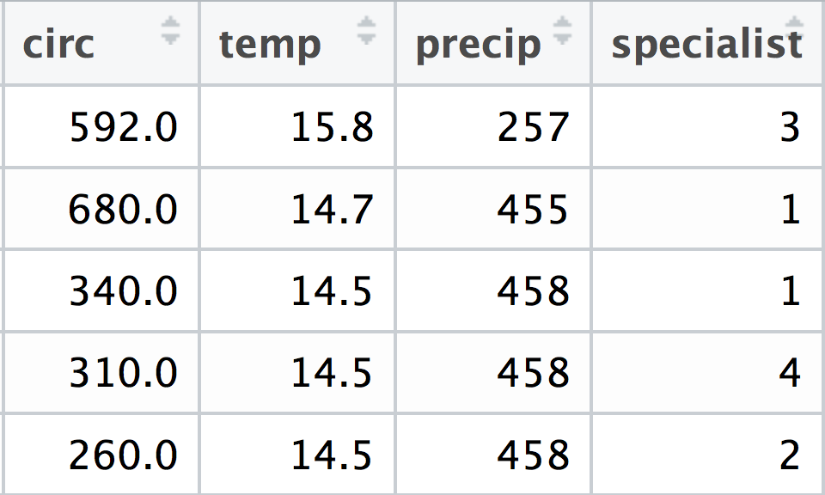
R versus the math oak example
$$y_{i}=β_{0}+β_{1}{temp}_{i}+β_{2}{circ}_{i}+β_{3}{{temp}_{i}circ}_{i}$$

Slide 22
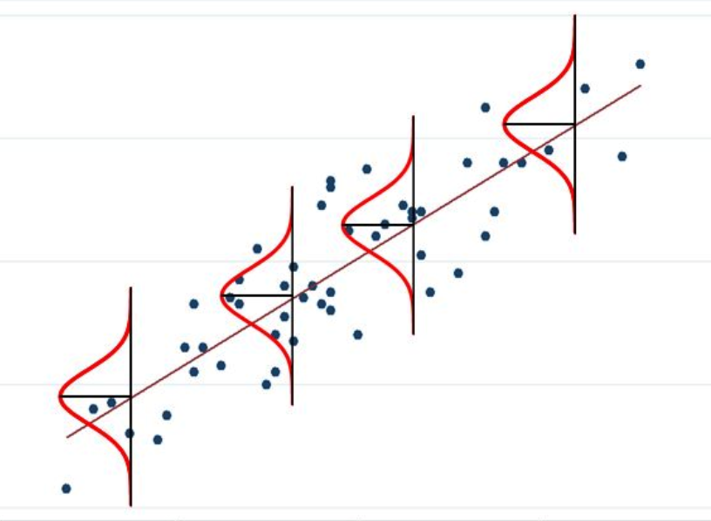
When the response variable isn’t normal

Slide 23
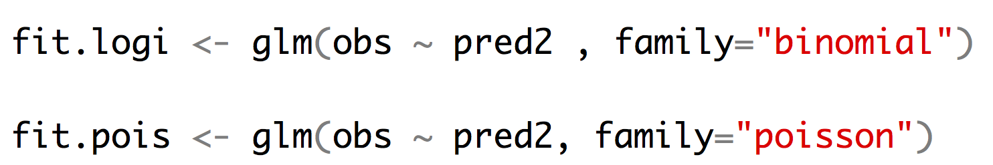
Other kinds of regression
Logistic regression allows us to fit a binary response variable (absent/present; alive/dead) with one or more categorical or continuous predictor variables.
Poisson regression allows us to fit a response variable that is Poisson distributed (number of extinctions in a unit of time, number of colonies per plate, (number of occurrences for rare events)) with one or more categorical or continuous predictor variables.

Slide 24
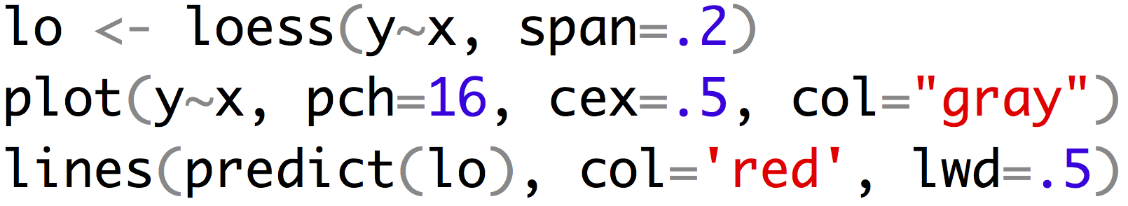
Sometimes regression isn’t best choice

Slide 25
For Thursday
Read chapter WS 17
Bring laptop to class!
Heath Blackmon
BSBW 309
coleoguy@gmail.com
@coleoguy

Slide 26
Models
"Remember that all models are wrong; the practical question is how wrong do they have to be to not be useful.”
George Box

